Slide 1

FoodRunner
By – Arpit Goel
E. No. - 41814802718

Slide 2
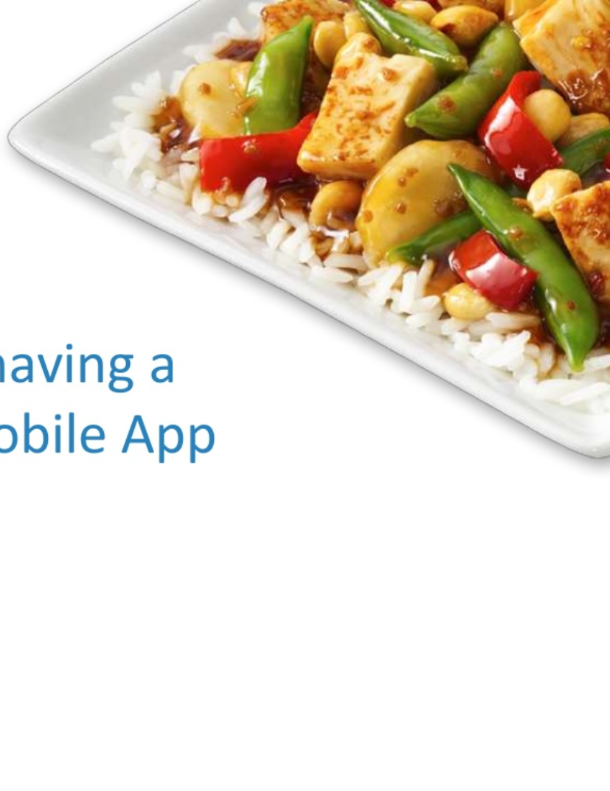
About
An Online Food Ordering Android App that evokes the brand and introduce the menus in the most interactive manner.
Digital Menu will Of robust features that not only help restaurant to update the menu anytime durable improve the all mobile experience for the Customer.
The Application will support Android platform giving customers.

Slide 3
Introduction
An Online Food Ordering Android App consisting of the following features :
Navigation Drawer - with the app logo and user
name on top and menu options to open the
following pages:
a. Home
b. User Profile
c. Favorite Restaurants
d. Order History
e. Frequently Asked Questions(FAQs)
f. Log out

Slide 4
Continued...
Login / SignUp – user has to login / SignUp to the
app before ordering food.
Home Page – contains list of restaurants
Menu – contains list of dishes for the particular
restaurant
Favourite Screen – shows favourite restaurant list
and can be edited by user
Welcome page - which displays the logo and name
of the app

Slide 5
Continued...
Order History - shows the user’s previous orders
My Profile Tab - shows the details of user
Forgot Password - from here user can reset his
password
FAQ - from here the user can find useful information of the app
Cart - which display the lists of items added to cart
and the total amount to be paid
Sort – user can sort menu menu according to cost

Slide 6
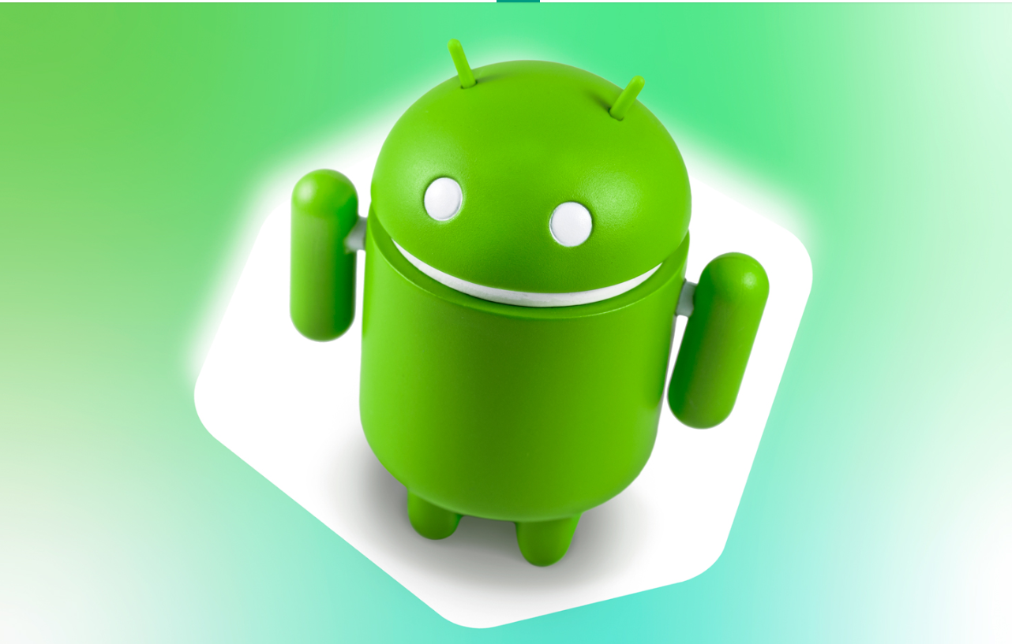
Technology/Tools Used
Android Studio
Kotlin
XML
JSON

Slide 7
Dependency
Server Availability
Internet

Slide 8
Concepts Used :
Working with Navigation View
Understanding Fragments
Recycler with Data
Connecting to the Internet
Requests and Threads
Fetching Data using GET Request
Fetching Data using POST Request
Databases
ROOM: Make Room for it

Slide 9
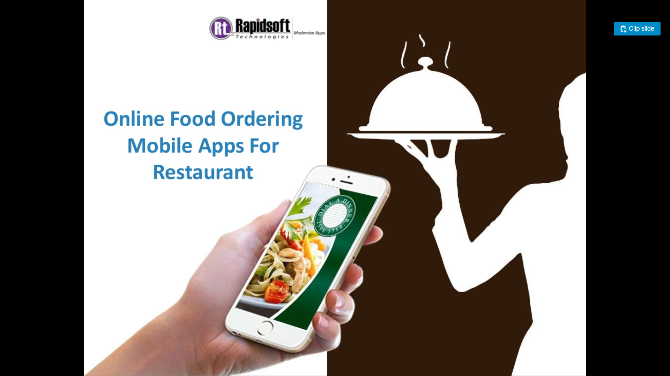
Overview of the App:

Slide 10
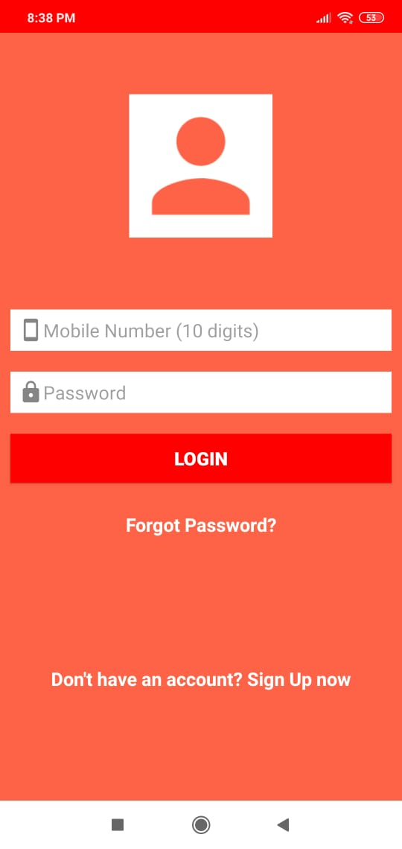
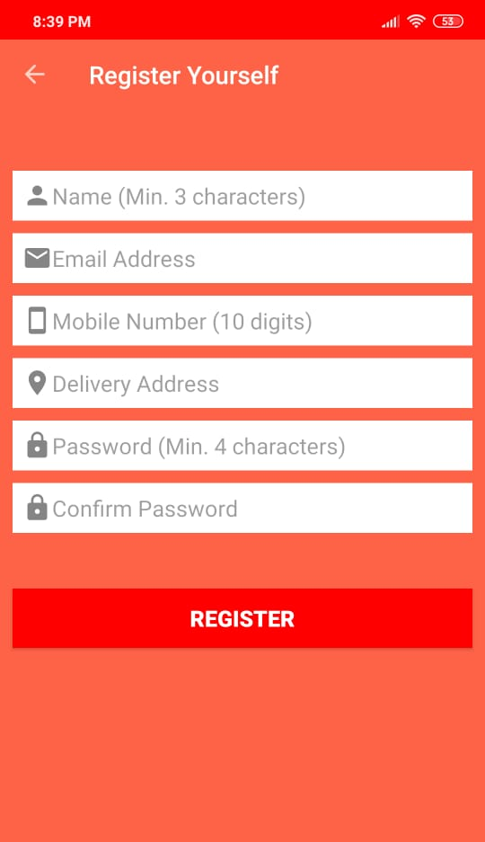
Login Page
Registration Page

Slide 11
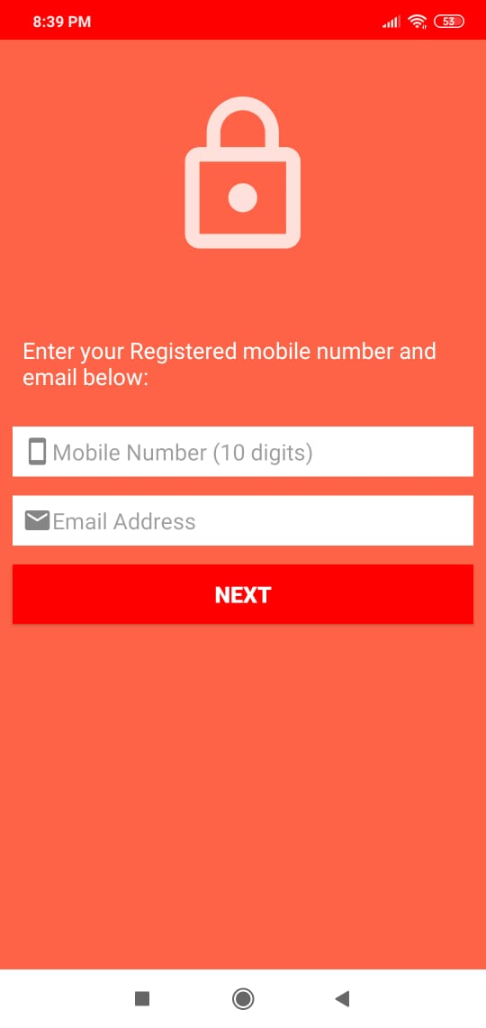
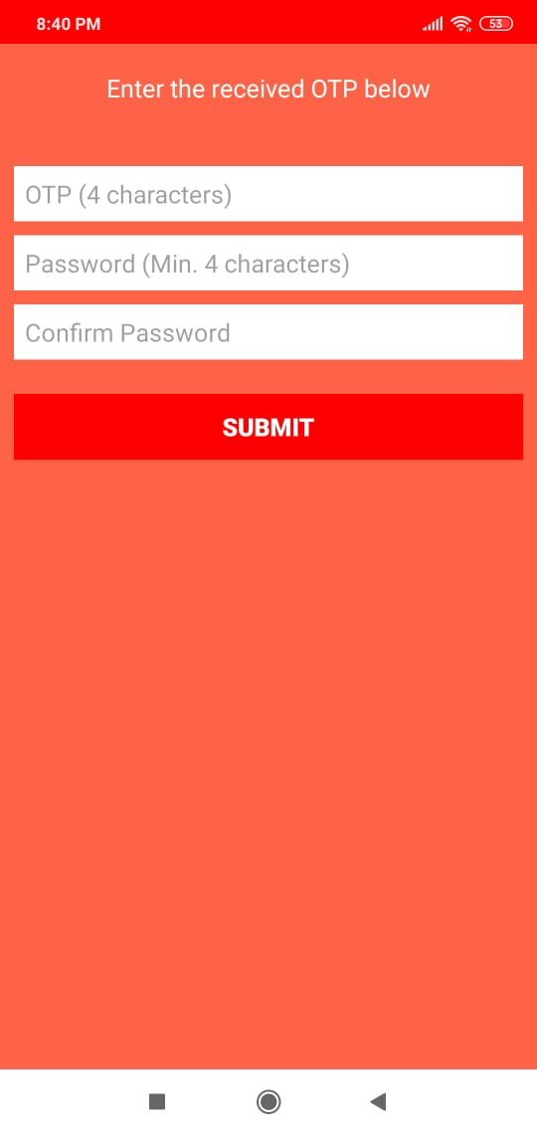
Forgot Password Page :
The page is used to reset the user password. This will be a two-step process.
Step 1
Step 2

Slide 12
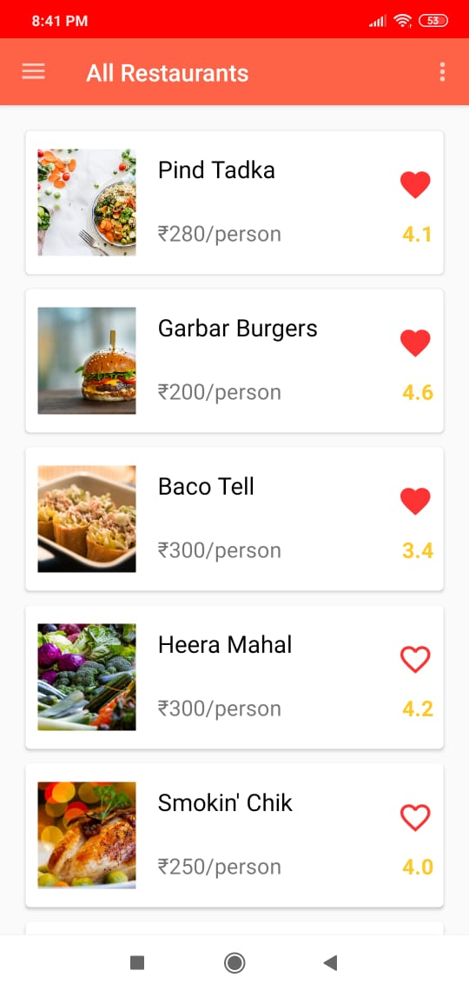
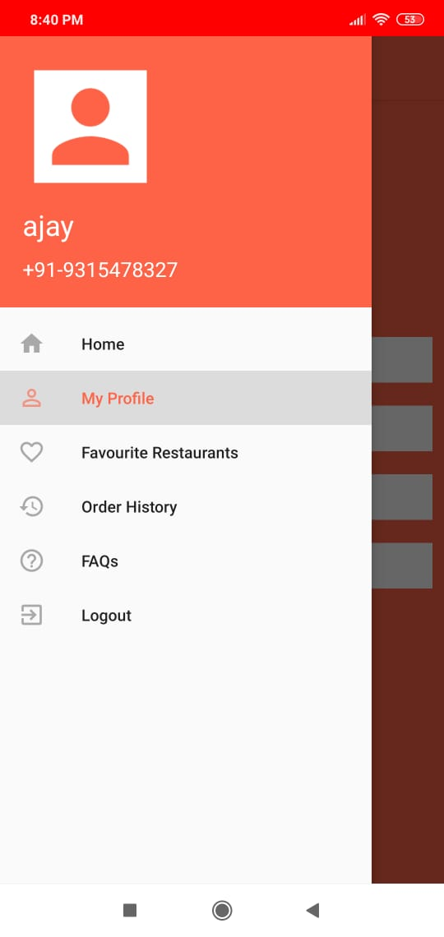
Home Screen :
Start Your Order
Navigation :
Home
My Profile
Favorite Restaurants
Order History
FAQs
Logout

Slide 13
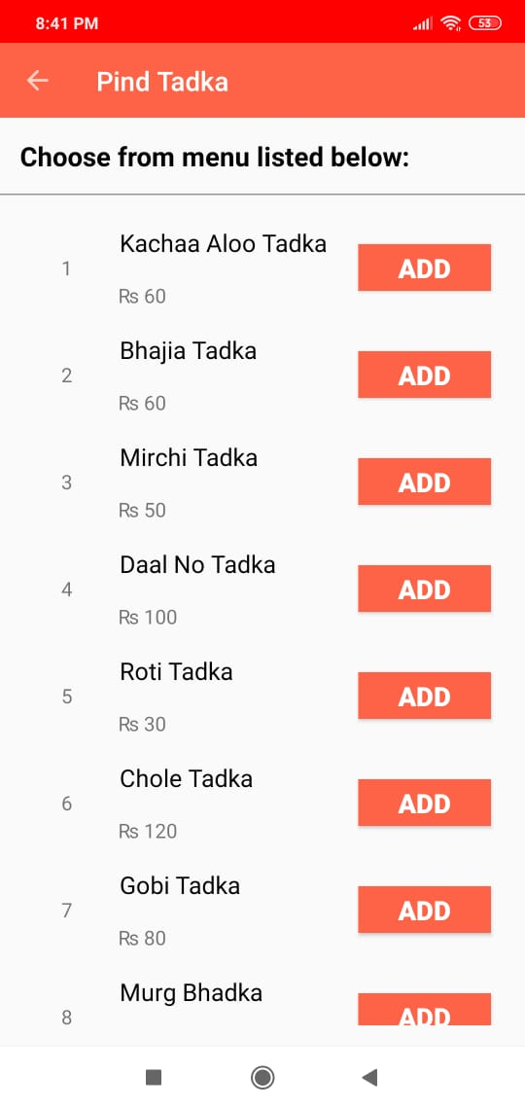
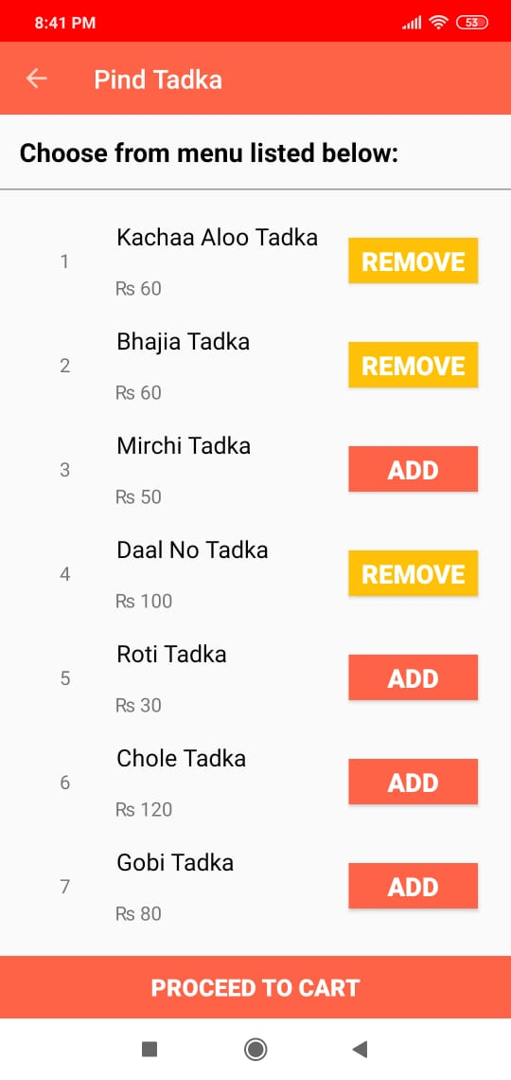
Restaurant Details Page :
The restaurant details are used to display the menu of the restaurant.

Slide 14
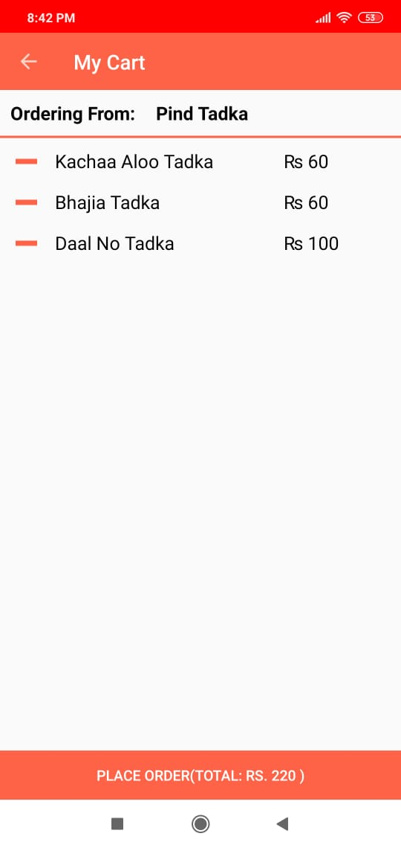
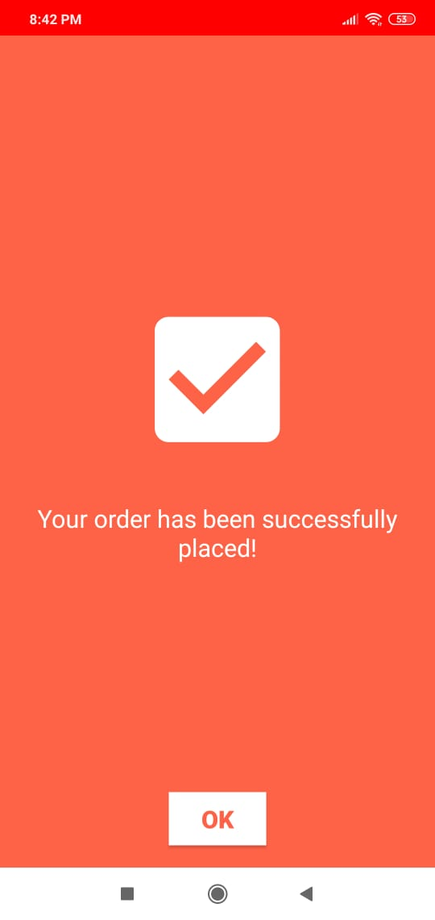
Cart Page :
The cart page contains all the items added to the cart along with their individual prices.

Slide 15
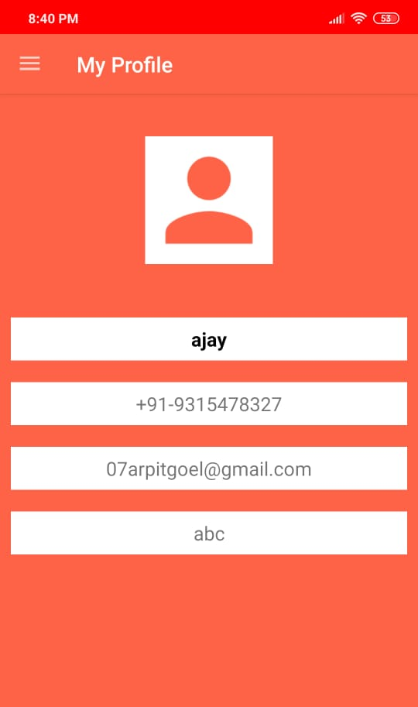
My Profile :
This page opens up from the navigation drawer. Your details i.e. Name, Phone number, and Address is shown here.

Slide 16
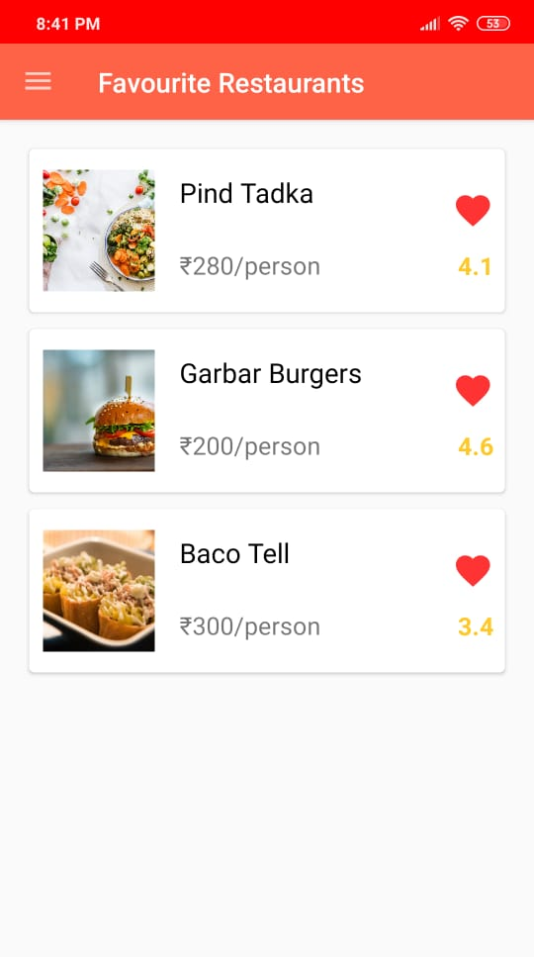
Favorites :
This page contains the list of the restaurants which were marked as a favourite by you. These are fetched from the local database.

Slide 17
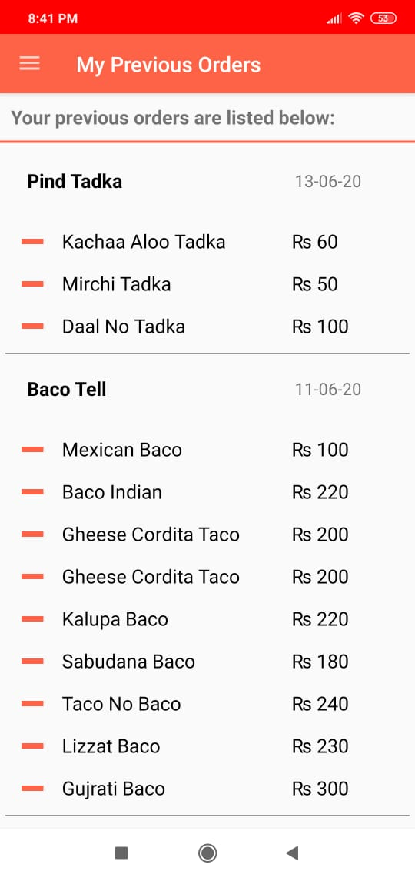
Order History :
This page contains the list of the food items you have previously ordered, arranged in reverse chronological order. The details to be provided on this page are:
1. Restaurant name
2. Food items list
3. Cost of each item

Slide 18
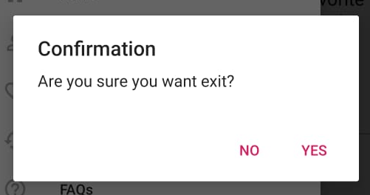
Logout :
This option is provided in the navigation drawer to log out of the application. This is a simple log out which redirects the user to the login page while clearing all the preferences stored.

Slide 19
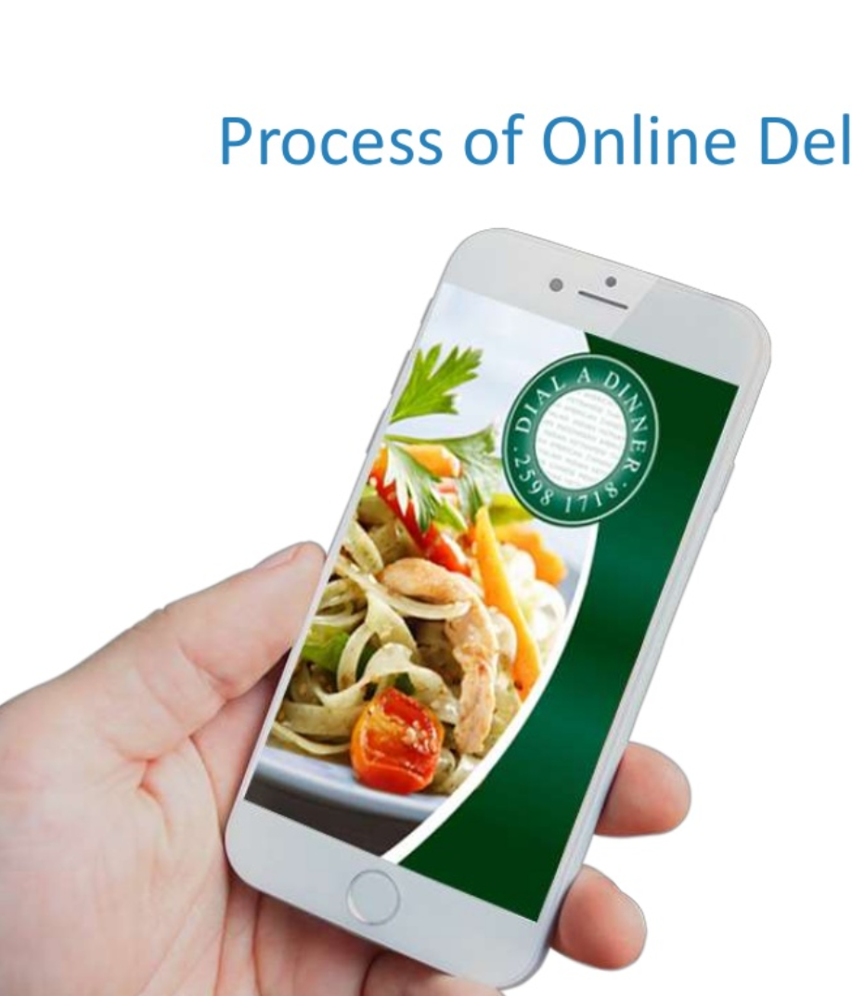
Process of delivery of Food :

Slide 20
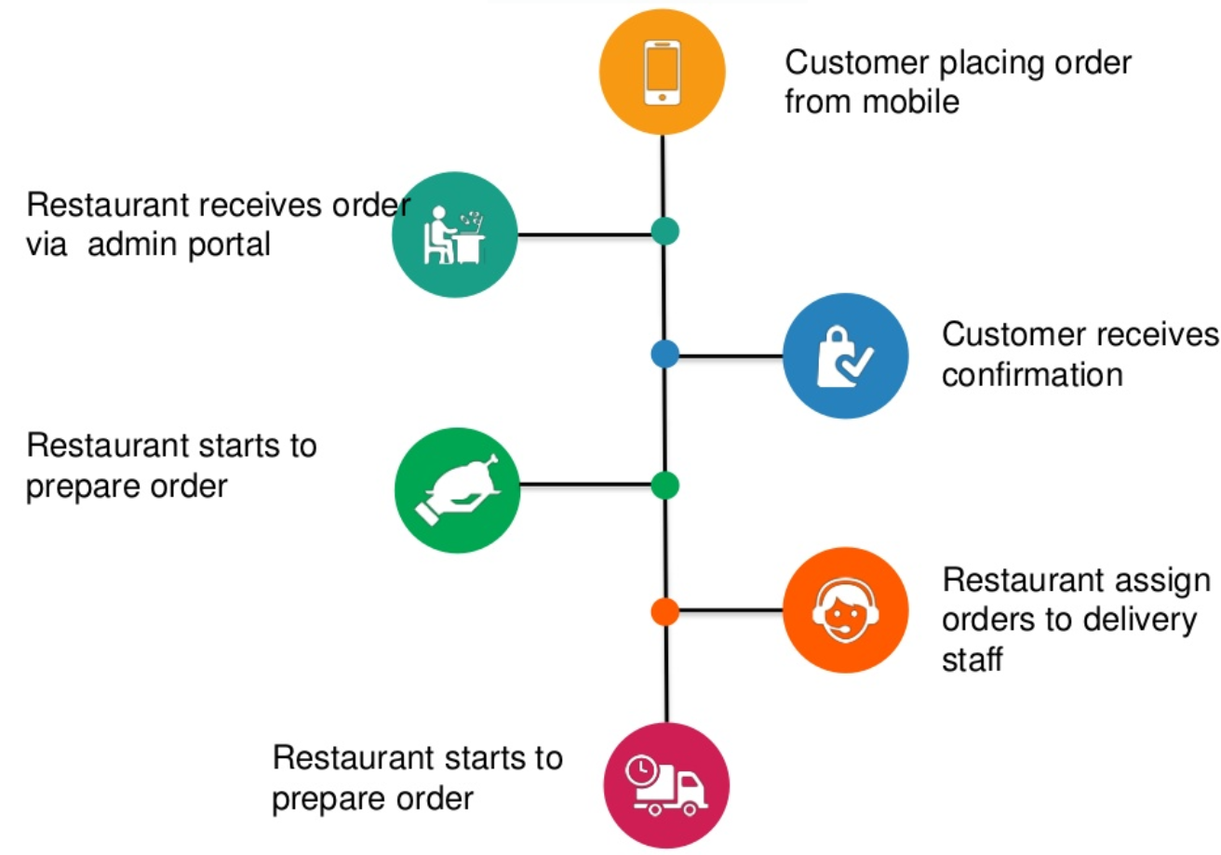

Slide 21
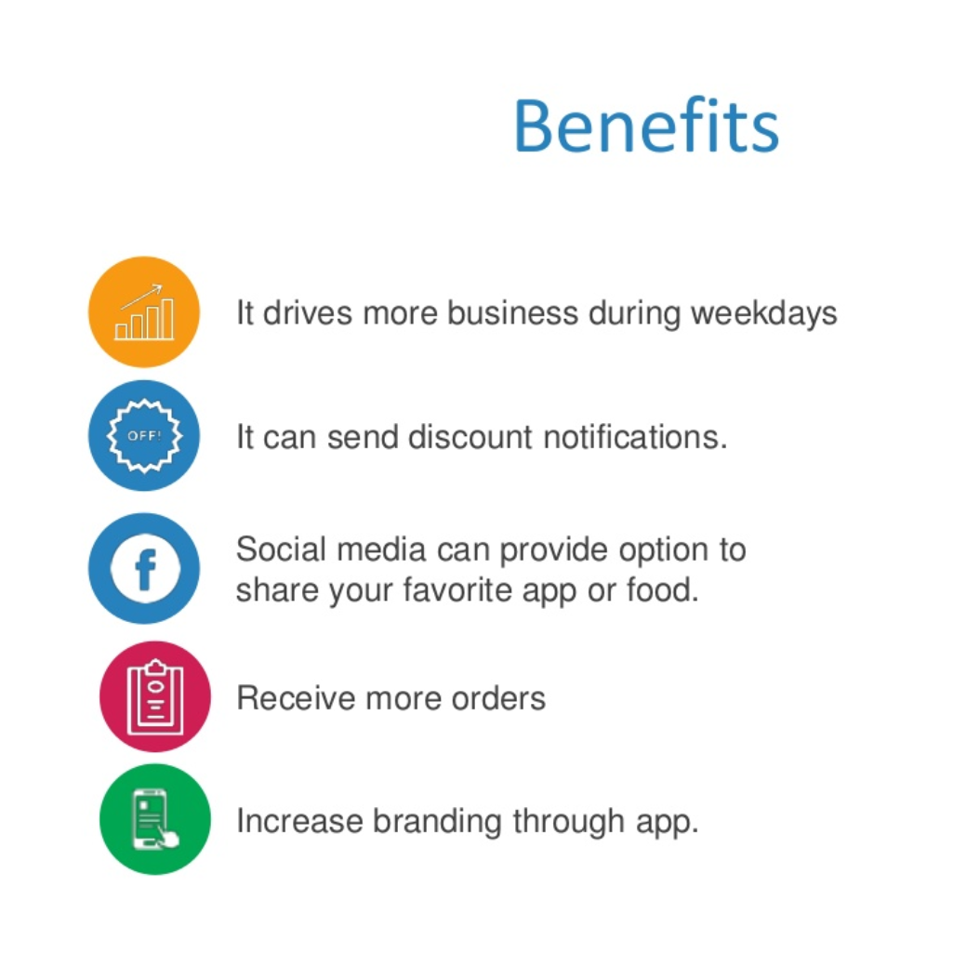
Benefits

Slide 22
Thank You

